Slide 1

PIP2001 Capstone Project
Review-0
Donor Hub
Batch Number:
Roll Number | Student Name
20211CSE0289 | BHARGAVI S
20211CSE0745 | KIRAN KUMAR KC
20211CSE0629 | RAHUL GOWDA V
Under the Supervision of,
Mr.Ramesh T
Assistant Professor
School of Computer Science and Engineering
Presidency University
Name of the Program: CSE
Name of the HoD: Dr.Asif Mohammed H.B
Name of the Program Project Coordinator: Dr. Jayanthi. K.
Name of the School Project Coordinators: Dr. Sampath A K / Mr.Jerrin / Mr. Md Ziaur Rahman

Slide 2
Content
Problem Statement
Github Link
Analysis of Problem Statement
Timeline of the Project
References

Slide 3
Problem Statement Number: PSCS_295
Organization: AICTE, MIC-Student Innovation
Category (Hardware / Software / Both) : Software
Problem Statement :
Blood donation centers often struggle with maintaining an updated donor database and responding efficiently to urgent blood requests. Traditional paper-based or fragmented systems lead to delays, inefficiency, and lack of transparency in managing blood group availability.
Difficulty Level: Simple

Slide 4
Github Link
The Github link provided should have public access permission.
https://github.com/BhargaviShankar123/Blood-Bank-Donor-Management-System-using-Python-Django-and-MySQL

Slide 5
Analysis of Problem Statement
The project utilizes a combination of technologies, including web development frameworks, databases, and communication protocols to deliver a secure and efficient donor management solution.
Frontend (Web): HTML, CSS, JavaScript, Bootstrap, AJAX, jQuery
Backend: Django (Python Web Framework)
Database: MySQL
APIs: RESTful APIs for secure data handling and communication between modules
IDE Used: PyCharm
Supported Web Browsers:Google Chrome, Mozilla Firefox, Opera, Internet Explorer 8+

Slide 6
Objectives
To enhance the management of blood donation and availability
To connect blood donors and recipients efficiently across different locations
To provide a secure platform for storing and accessing donor information
To enable fast and accurate search based on blood group and city

Slide 7

Analysis of Problem Statement (contd...)
Website
Provides donor registration and blood request services.
Offers a simple and user-friendly interface for users, donors, and admins.
Backend
Handles storage, retrieval, and processing of donor and request data.
Manages user authentication and access control.
Database
Stores donor details, blood groups, and blood request records.
Maintains contact queries and admin reports.

Slide 8

Analysis of Problem Statement (contd...)
Hardware Requirements:
Servers: For backend processing and data management.
Network Infrastructure: For communication.
User Devices: Mobile devices, tablets ,computers.

Slide 9
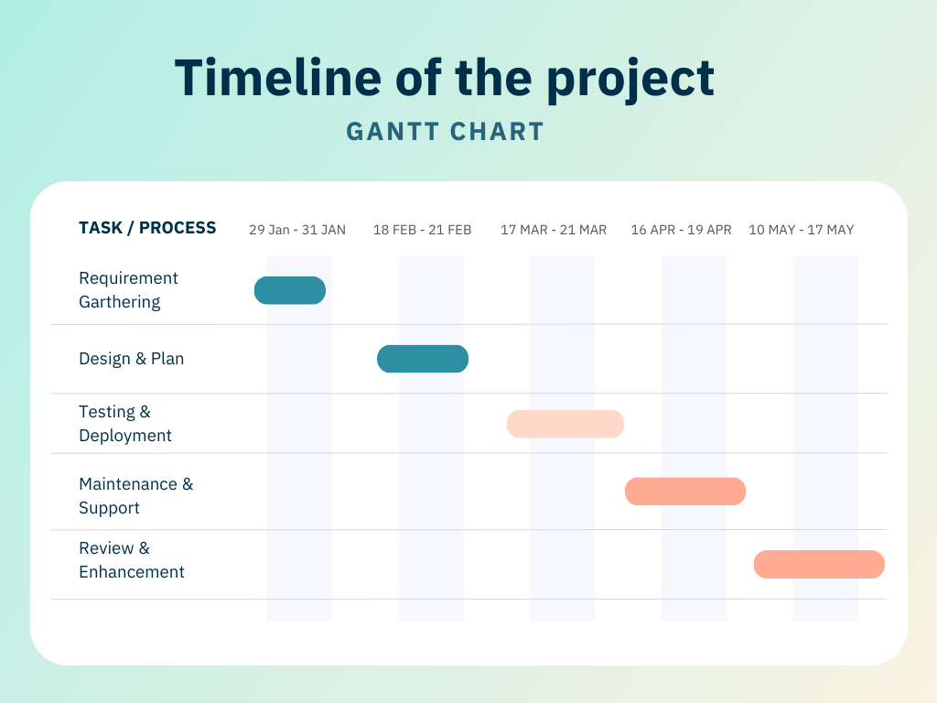
Timeline of the Project (Gantt Chart)

Slide 10
References (IEEE Paper format)
S. M., D. R., D. D. S., and S. S., "Blood Donors and Blood Banks Tracking Applications," 2023 2nd International Conference on Advancements in Electrical, Electronics, Communication, Computing and Automation (ICAECA), Coimbatore, India, 2023, pp. 1–6. Paper Link: https://ieeexplore.ieee.org/document/10200259
J. Kaur, A. Gupta, A. Tripathi, A. K. Gupta, and A. Srivastava, "RaktFlow - Blood Bank Management and Donation System," 2022 OPJU International Technology Conference on Emerging Technologies for Sustainable Development (OTCON), Raigarh, Chhattisgarh, India, 2023, pp. 1–6. Paper Link: https://ieeexplore.ieee.org/document/10113983
R. Elakya, M. Dhanam, B. Hemnaath, R. Dhanalakshmi, M. Gayathri, and H. B. I., "Blood Donor Management System - An Android Based Model and Implementation," 2022 Third International Conference on Intelligent Computing Instrumentation and Control Technologies (ICICICT), Kannur, India, 2022, pp. 607–614. Paper Link: https://ieeexplore.ieee.org/document/9917630
M. Kaur et al., "A Web-based Blood Bank System for Managing Records of Donors and Receipts," 2022 International Conference on Computational Intelligence and Sustainable Engineering Solutions (CISES), Greater Noida, India, 2022, pp. 459–464. Paper Link: https://ieeexplore.ieee.org/document/9844389
Q. Qian, W. Xu, W. Li, B. Wang, L. Wang, and Q. Zhou, "Accurate Detection of Chylous Blood Levels by Deep Learning," IEEE Access, vol. 10, pp. 73988–73996, 2022. Paper Link: https://ieeexplore.ieee.org/document/3189369
D. Hawashin et al., "Blockchain-Based Management of Blood Donation," IEEE Access, vol. 9, pp. 163016–163032, 2021. Paper Link: https://ieeexplore.ieee.org/document/3133953
H. D. Das, R. Ahmed, N. Smrity, and L. Islam, "BDonor: A Geo-localised Blood Donor Management System Using Mobile Crowdsourcing," 2020 IEEE 9th International Conference on Communication Systems and Network Technologies (CSNT), Gwalior, India, 2020, pp. 313–317. Paper Link: https://ieeexplore.ieee.org/document/9115776
P. A. J. Sandaruwan, U. D. L. Dolapihilla, D. W. N. R. Karunathilaka, W. A. D. T. L. Wijayaweera, W. H. Rankothge, and N. D. U. Gamage, "Towards an Efficient and Secure Blood Bank Management System," 2020 IEEE 8th R10 Humanitarian Technology Conference (R10-HTC), Kuching, Malaysia, 2020, pp. 1–6. DOI: 10.1109/R10-HTC49770.2020.9356980 Paper Link: https://ieeexplore.ieee.org/document/9356980
P. Govender and A. E. Ezugwu, "A Symbiotic Organisms Search Algorithm for Optimal Allocation of Blood Products," IEEE Access, vol. 7, pp. 2567–2588, 2019. DOI: 10.1109/ACCESS.2018.2886408 Paper Link: https://ieeexplore.ieee.org/document/8633941
T. Palaniappan, K. G. Mahalakshmi, and K. Vidhya, "Cloud-Based Blood Bank System Using Blockchain for Transparent Donation and Distribution," 2023 International Conference on Computational Intelligence and Sustainable Engineering Solutions (CISES), Greater Noida, India, 2023, pp. 112–117. DOI: 10.1109/CISES58789.2023.10122876 Paper Link: https://ieeexplore.ieee.org/document/10122876

Slide 11


